Slide 1
The Identification Game!
May 22nd 2020
ACSE-4 Group Project
Team Dropout

Slide 2
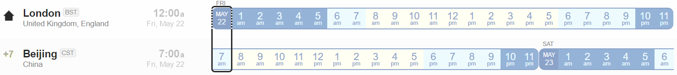
Organisation of the group
Conference call for work progress
3 People
2 People
Microsoft Teams
Notes:
ALEX
We did not need a set team leader, as all team members were very good at communicating and listening to different ideas
To deal with different time zones, we separated into two sub-teams, one in China and one in the UK
We defined tasks at the beginning of the day (UK time) , then at the end of the day (UK time) for each sub-team to complete (while the other sub-team is sleeping?)
This ensured we were not wasting time.
We split up trying out different approaches and the hyperparameter optimisation between team members so we could try more combinations

Slide 3
Analysis & processing of input data What our dataset looks like
How important are grayscale vs. color images?
Total grayscale images in training set: 1821
This represents only 1.8% of the data
Conclusion: grayscale images are not significant – it would be better to convert them to a 3 channel image (PyTorch already does this)
Notes:
FAZAL

Slide 4
Analysis & processing of input data What we want out data to look like
Scikit’s Stratified Shuffle Split
PyTorch’s Random Split
How should we split our data?
We aimed to get an even number of classes in both the training and validation to increase generalizability
We had a choice between PyTorch’s random split and Scikit’s stratified shuffle split
Conclusion: no big difference between them for a large, evenly spread starting dataset
Notes:
FAZAL

Slide 5
Analysis & processing of input data Further points of interest
The RGB mean range looks interesting
The data seems to be slightly skewed toward the red channel. Can this be exploited to gain further accuracy?
The variation per channel seems consistent; standard deviations are all relatively similar
Notes:
FAZAL

Slide 6
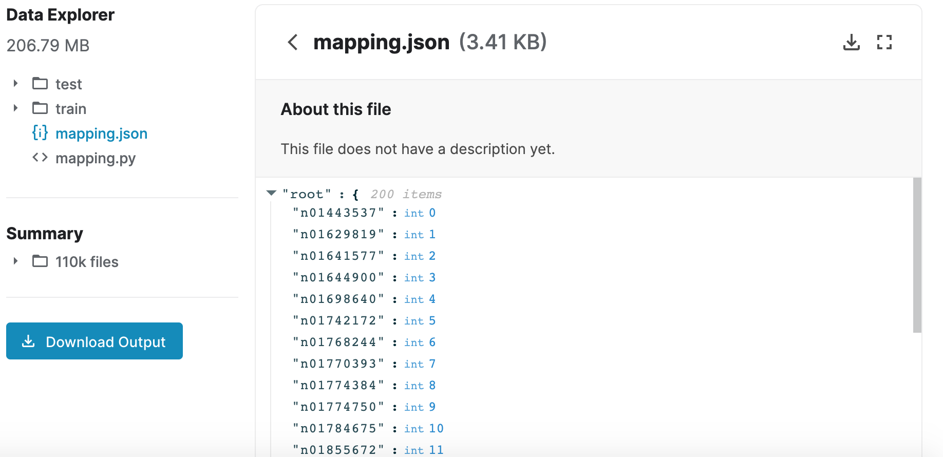
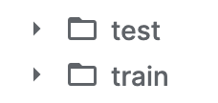
Analysis & processing of input data Looking forward: increasing the training data
We considered a number of strategies to increase our training set size
GANS: These looked promising but we were short on both time and GPU resources, so we looked for another option. There was also a question of how much more the model could learn from data generated from the existing training set
We seemed to be out of luck….
A potential goldmine
Web-scraping: Using the labels provided in the mapping.json file, we could potentially mine many more images to increase our dataset and gain extra performance
Caveats: We may grab existing images, these need to be filtered
=
++
++
Notes:
FAZAL

Slide 7
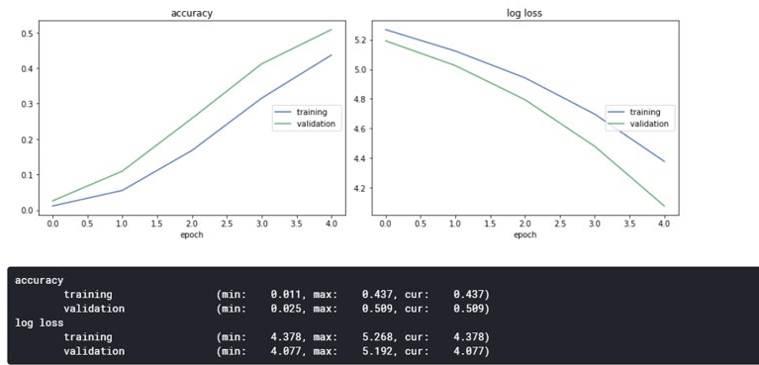
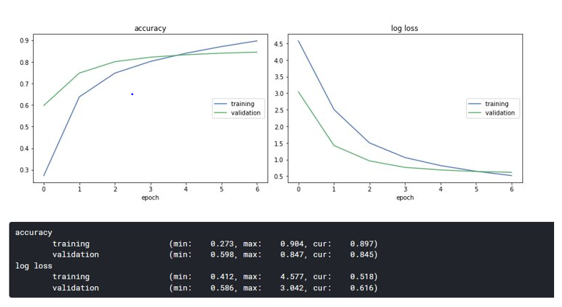
Validation & hyper-parameter selection
80/20
Grid search
Bayesian approach
Notes:
ALEX
- To perform validation of our models, prior to testing on Kaggle, we split up the data using random split with a ratio of 80/20, i.e. held back 20% of data for validation.
We then calculated validation and training accuracies at each epoch, which were obtained using the sci-kit learn accuracy_score function.
To optimise the hyperparameters, we used a simple grid search, where we changed one hyperparameter over a specified range and kept all other parameters constant.
Data augmentation
Computational time severely limited the number of times we could run our model, so we just did the best we could with the computational resources available and ran as many different combinations of parameters as possible
A Bayesian approach could be a more robust way of optimising hyperparameters in the future

Slide 8
Approaches for final submission
Conference call for work progress
3 People
2 People
Microsoft Teams
Decision
Framework
Search for options and possible outcome
Work on options
Use best option and eliminates others.
Build own model
VGG19
Fine tuning with same hyper parameters
Grid search on hyper parameters
Analysis possible mode behavior with current input and model architecture
Perform prediction
Search for best hyper parameters
wide_resnet101_2
Resnet18
Utilize pretrained model
Densenet121
tweak hyper parameters
Resnet34
Time constraint
Computational Resources
Time difference
Information availability
Using pretrained from pytorch will benefit us more based on those aspects
Ensemble method
resnext50_32x4d
resnet152
Incorporate all models to find the best outcome
wide_resnet101_2
Notes:
Ok so now Andika is going to talk a bit more about our overall process which led to our best performing model, as well as the details of that model

Slide 9
Approaches for final submission
Resnet18 with finetuning was submitted for the first submission to know how Kaggle score behavior and this model has the simplest architecture thus it is faster to train compared to other.
PReLU didn’t perform better than ReLU. This might be possibly due to we are using pretrained model where the weight has been initialized to imageNet images thus PReLU provides no further benefit .
Data augmentation can increase both validation and testing accuracy but taking longer time to train.
With limited time and computation resources, our team decided to use deeper / wider method to increase accuracy
Almost all model was run up to 5 epoch. This is due to overfit of our data (those models were based on imagenet which has way more images than our current data set.

Slide 10
Approaches for final submission
Resnext50 wasn’t chosen cause Pytorch has deeper and wider models that can classify our image better.
Wider model is chosen compared to deeper model (wide 101_2 over 152). The reason is based on above data that accuracy are better in wider model and this is conforming Delving Deep Paper saying deeper models tends to diminishing improvement or even degradation on accuracy.
Smaller learning rate (lr), 5E-4 was chosen as the trend of accuracy increase when lr got smaller.
Data augmentation also improving a bit of accuracy but it took longer time to finish one epoch.
With limited time and computation resources and result from grid search in hyper parameters, our team decided to use wide_resnet101_2 to be the final submission.

Slide 11
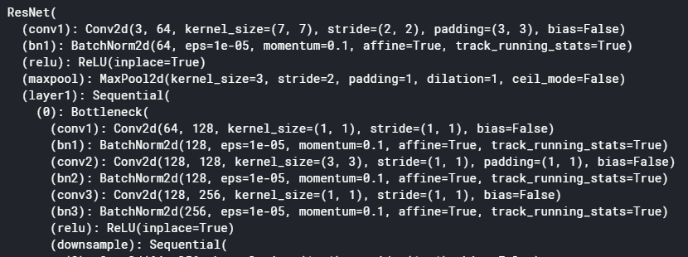
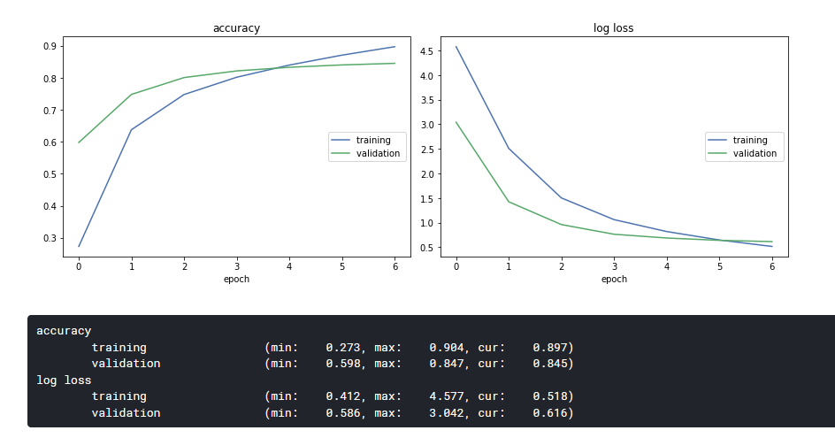
Approaches for final submission A bit of detail on our wide_resnet_101_2
Selected Hyper Parameters
Activation | ReLU
Learning Rate | 5e-4
Momentum | 0.6 (using SGD Optimizer)
Batch Size | 64
Number of Epochs | 7
Weight Decay | 1e-5
…
Adaptive change on last layer to accommodate our 200 classes.

Slide 12
Approaches for final submission Combining Models
Combining models using a weighted probability voting ensemble
We figured having an ensemble would boost performance
It would allow us to get a consensus vote on each image
We used the log softmax values from each model, and weighted them by either the score on the Kaggle leaderboard, or their validation accuracy
model
densenet121
wide_ resnet152
resnext50_32x4d
wide_resnet101_2
weight
0.74
0.809
0.807
0.84109
validation
validation
validation
Kaggle
These models were combined to produce a vote per image. The consensus vote was selected
Consensus
If we had time, we would have used per class weights, per model
This would have allowed much more flexibility in constructing the weights; potentially improving the accuracy
Ensemble Forecast
Kaggle score
0.84478

Slide 13
Approaches for final submission Voting Algorithm
For a particular image we calculate…
Weight | Model | class 1 | class 2 | class 3 | …
0.74 | densenet121 | p1 | … | … | …
0.809 | resnet152 | p2 | … | .. | …
0.807 | resnext50_32x4d | p3 | … | … | …
0.84109 | wide_resnet101_2 | p4 | … | … | …
 | Weighted Softmax Value: | 0.74*p1 + 0.809*p2 + 0.807*p3 + 0.84109*p4 ----------------------------------------------------------- 0.74 + 0.809 + 0.807 + 0.84109
Pick the class that gets the highest total weighted log softmax value
Inspiration: https://sebastianraschka.com/Articles/2014_ensemble_classifier.html

Slide 14
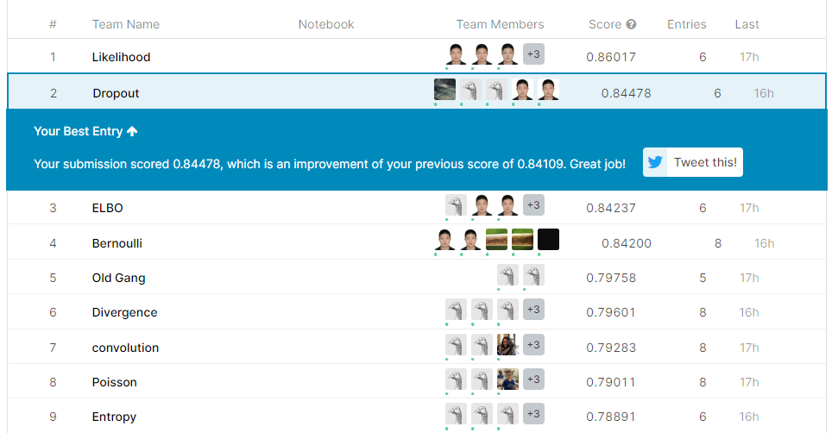
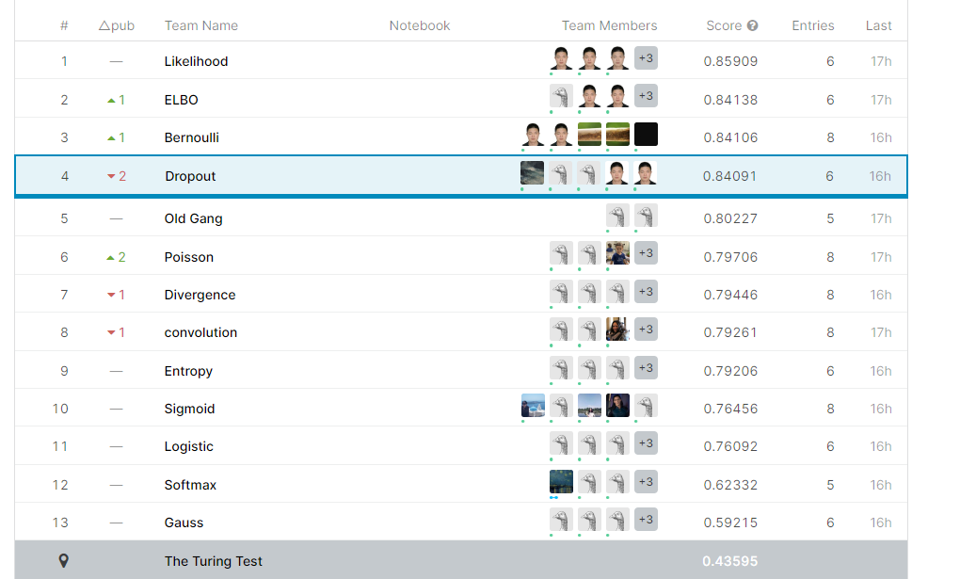
Conclusion & recommendations
Notes:
ALEX
Our group managed to work effectively despite time zone differences, with a final model accuracy of ~84 %.
Only 5 people. So less computational resources available than other 6 person groups
Wider and deeper CNNs tended to produce better results despite the risk of over-fitting. But after a certain point adding more layers did not improve model accuracy
Our best accuracies were achieved using a transfer learning approach, with a wide 101 layer ResNet pre-trained on ImageNet data and fine-tuned; or an ensemble approach combining several of our models
ENSEMBLE FAZAL
Ideally, we would also more robustly optimise our hyperparameters, for example by using a Bayesian approach.

